Slide 1
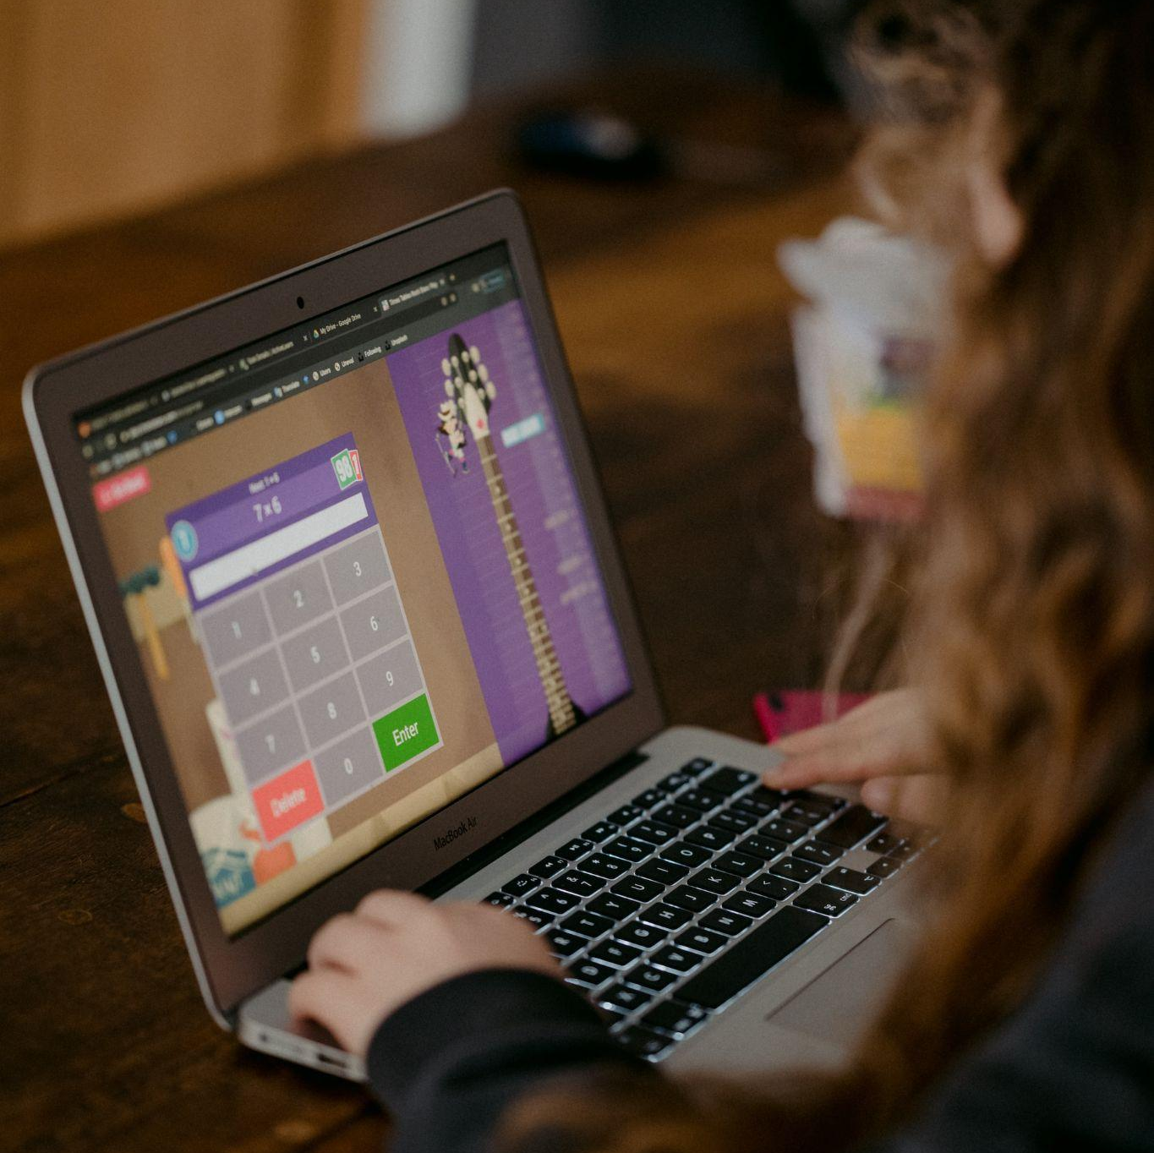
Day 6:
Quiz App
Introduction
Notes:
Photo by Annie Spratt on Unsplash

Slide 2

Your 6-Day Success Plan
You have done this!
Day 0 (30 mins):
Roadmap to Software Dev
Learn the pros of being software dev
Learn the step by step to be software dev

Slide 3
Your 6-Day Success Plan
You also have done this!
Day 1 (1h):
Learn creating a website using HTML
Create Your First Website
Understand how websites understand HTML
Use HTML to create links & texts
Build a resume website

Slide 4
Your 6-Day Success Plan
You also have done done this!
Day 2 (1h):
Learn to style a website using CSS
Styling Websites
Add your profile picture for employers!
Learn to create buttons and design them
Build a Link in Bio project

Slide 5
Your 6-Day Success Plan
You also have done done done this!
Day 3 (1h):
Learn data types such as numbers & strings
Build Interactive Website
Understand how to store data in variables
Learn how to show data
Create BMI calculator

Slide 6
Your 6-Day Success Plan
You also have done done done done this!
Day 4 (1h):
Learn to get user inputs
Better BMI
Understand how to make website interactive
Create better BMI calculator

Slide 7
Your 6-Day Success Plan
You also have done done done done done this!
Day 5 (1h):
Learn how to create a list of quotes
Random Quote Generator
Show the quotes randomly
Create random quote generator

Slide 8

Your 6-Day Success Plan
We are currently here
Day 6 (1h):
Learn how to if answer is correct
Quiz App
Show if the user got it right or not
Create quiz app

Slide 9
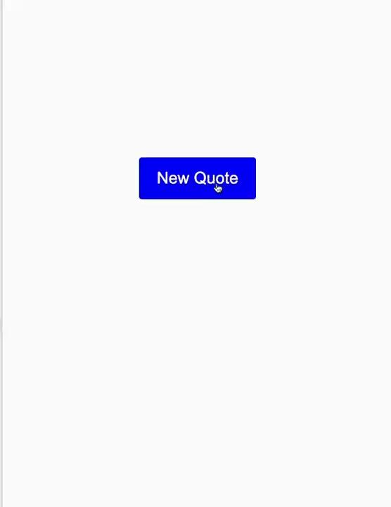
What you are building
A simple quiz app where you get it will show you whether you get it right or not.
What you are learning:
- How to check the user's answer against the correct answer using JavaScript
- Show if the user got it right or not
Demo project here.

Slide 10
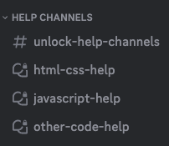
Need help?
We are happy to help with any issues, things you don’t understand in our Discord channel here.
Here is our full link:
https://discord.gg/yCrB7tfbhg
Once in discord, add your questions in our help channels.

Slide 11
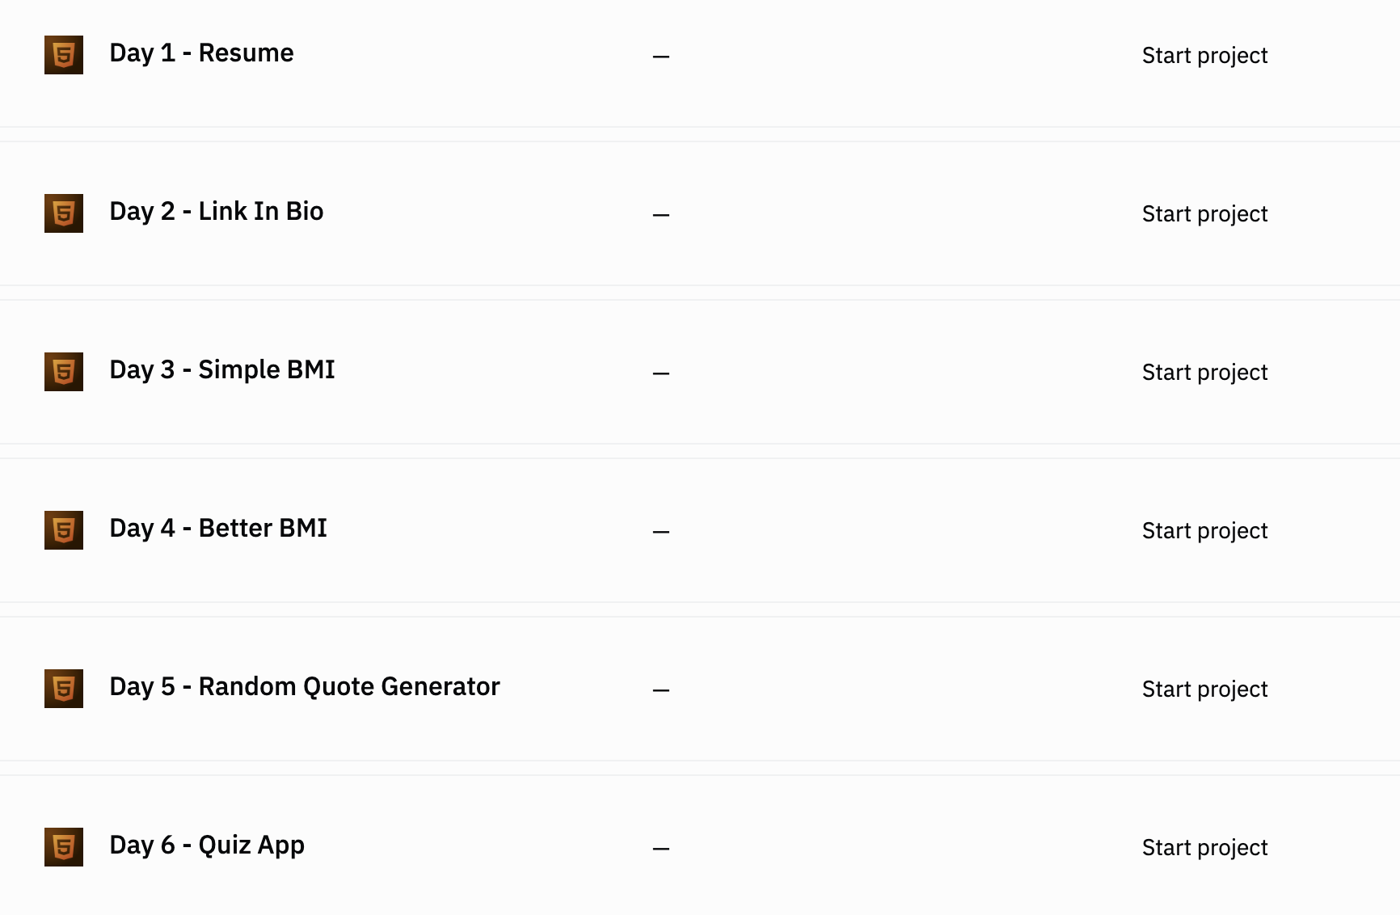

Go to our team dashboard: https://sig1.co/replit-6in6
You can click on Day 6 - Quiz App

Slide 12
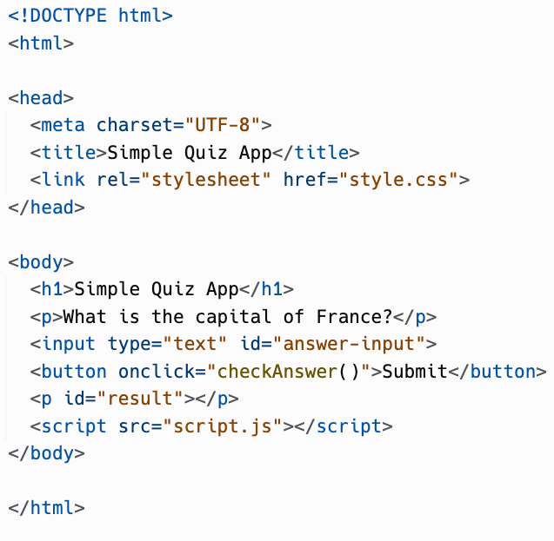
In index.html, update the code to this.

Slide 13
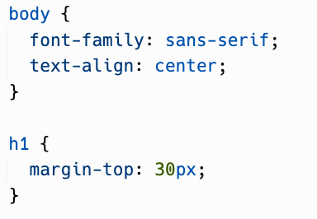
In style.css, update the code to this:

Slide 14
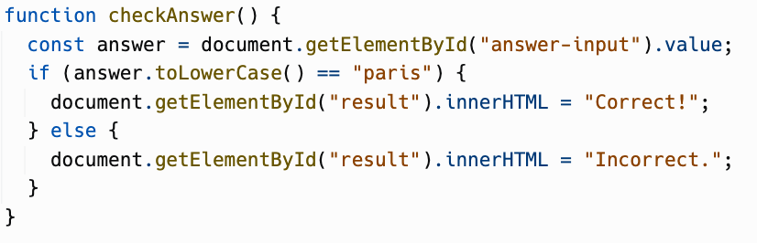
In script.js, add the code to this.

Slide 15
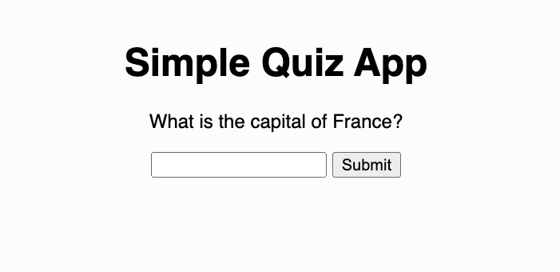
Run the project, and it should look like this.

Slide 16
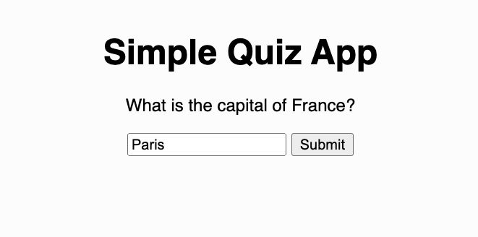
Type in the correct answer and click on submit:

Slide 17
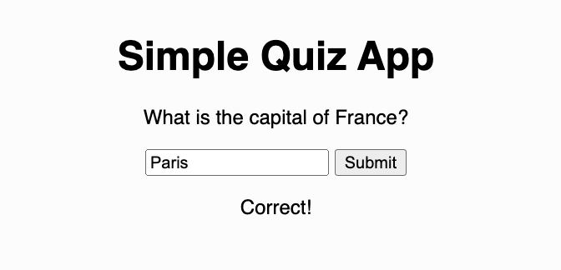
The word correct should appear. Now put a wrong answer…

Slide 18
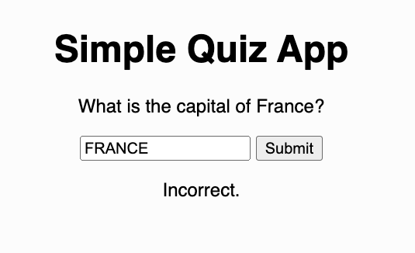
You should see the word incorrect. Let’s see the code that we have added!

Slide 19
index.html
Fairly straight forward. We have a heading, a questions, an input and a button to check the answer.
Below the button, we have an empty paragraph tag. This is where we change the innerHTML to Correct or Incorrect.

Slide 20
style.css
Nothing to fancy. We set the font family to sans-serif. We align our texts into the center. And we add a margin at the top. 30 px specifically.

Slide 21
script.js
We get the user’s input value. However, to check whether we got the answer correct, we use this thing called conditionals.
What are conditionals?

Slide 22
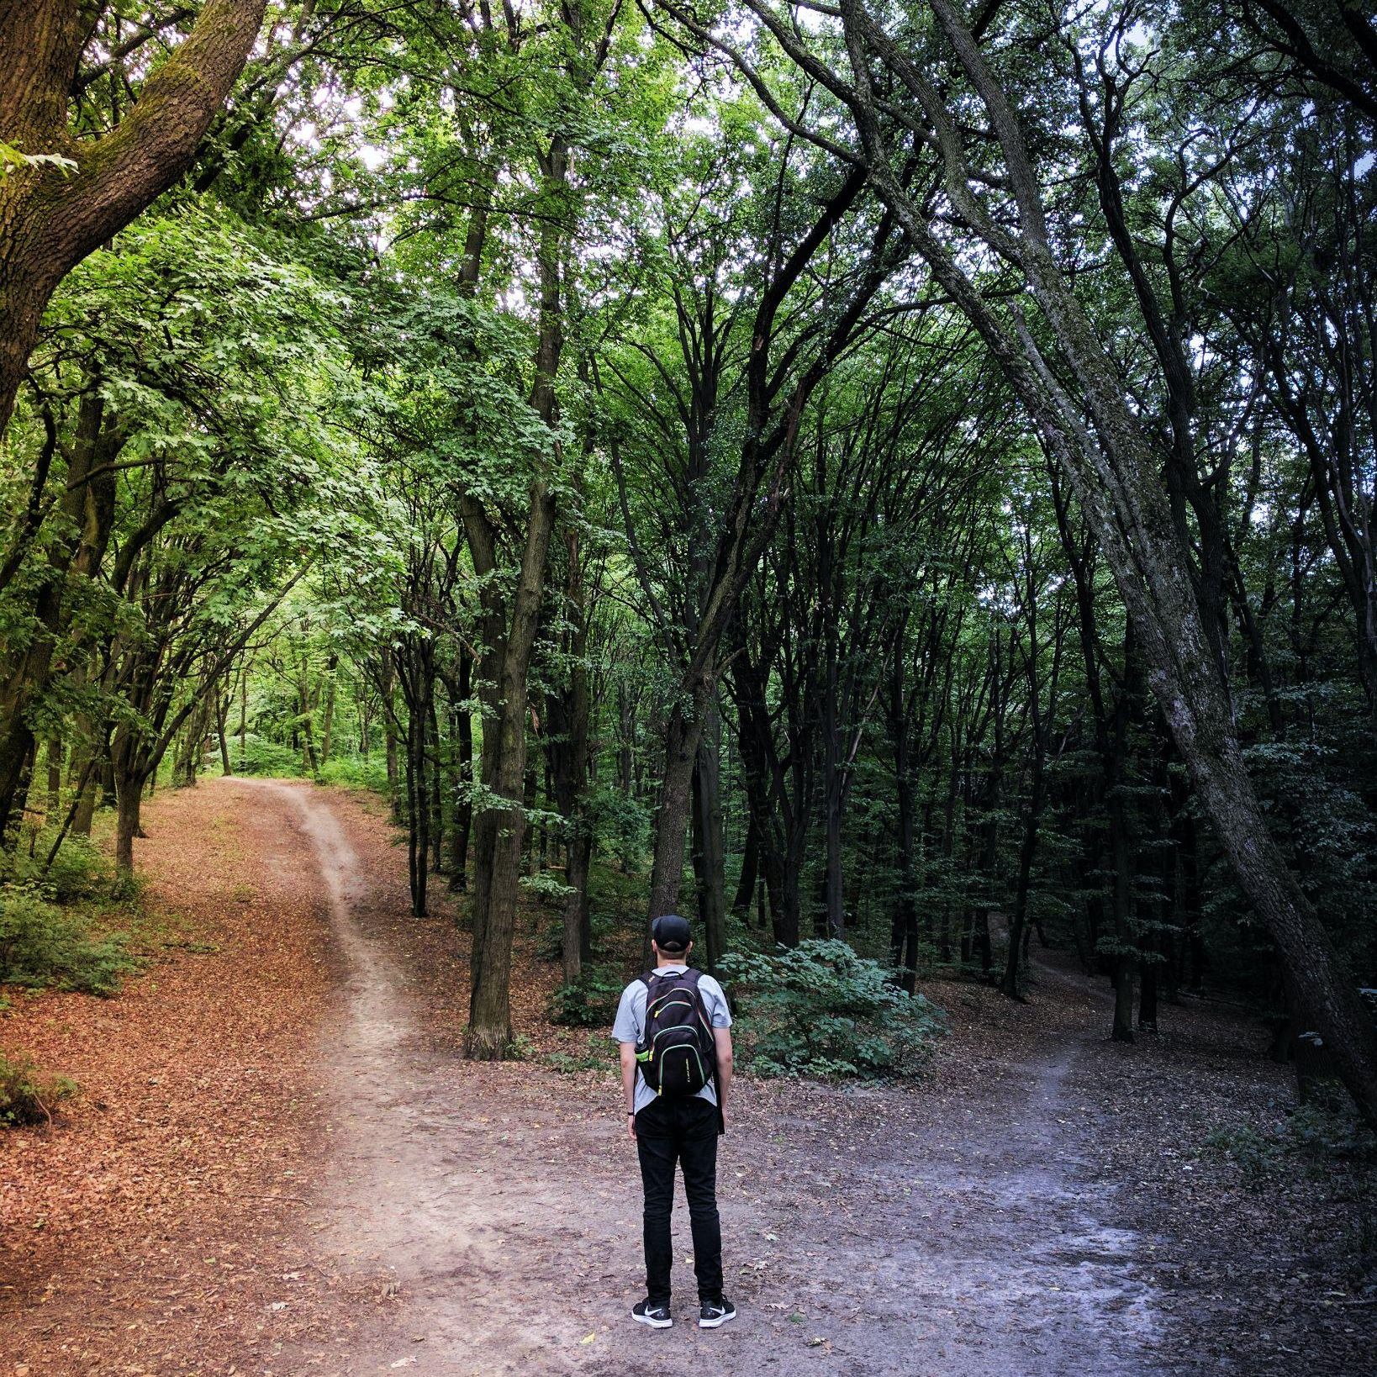
Conditionals
Notes:
Photo by Vladislav Babienko on Unsplash

Slide 23
Conditionals
This is how computers and humans make decisions.
In this example, we are comparing whether the user answer is the same as the correct answer ("paris").
Let’s break down the conditional. We also call it the if-else block.

Slide 24
Conditional statement
The code in the red box simply means:
If the answer, lower cased, is equal to "paris", then we…
And since the answer is "paris"...

Slide 25
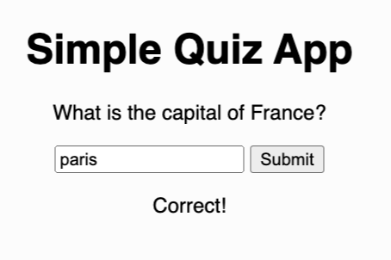
True
This means the statement is true, which will run the:
document.getElementById("result").innerHTML = "Correct!";
Which basically adds the "Correct!" text in the result paragraph.
What happens if it's not true?

Slide 26
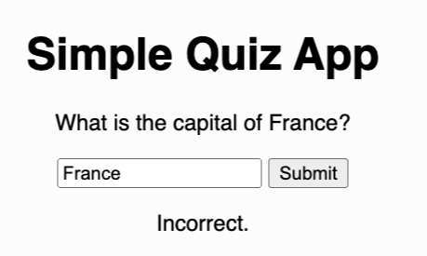
False
If the answer is not equal to "paris", we will run
document.getElementById("result").innerHTML = "Correct!";
Which basically adds the "Incorrect!" text in the result paragraph.
What if we have the answer are PaRiS? Will this be correct?

Slide 27
.toLowerCase()
Basically, we want to ensure that the comparing between the user's answer and the correct answer is the same case (or all lower case) and accurate.

Slide 28
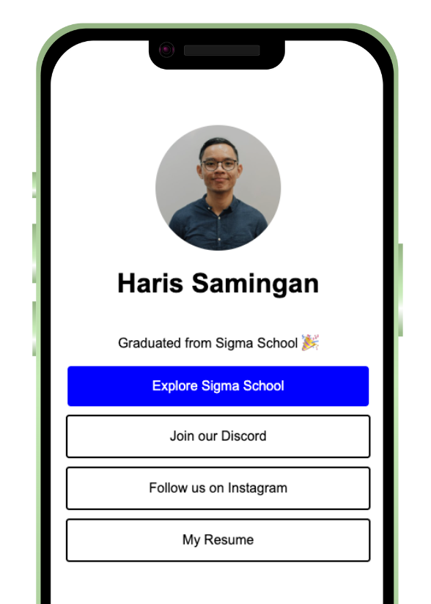
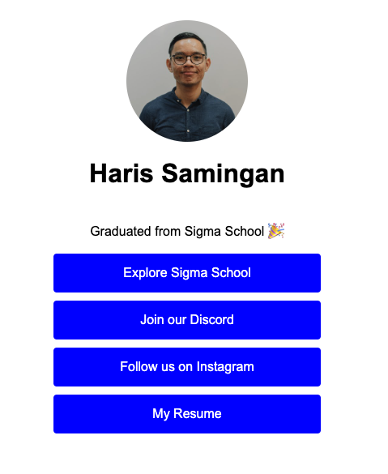
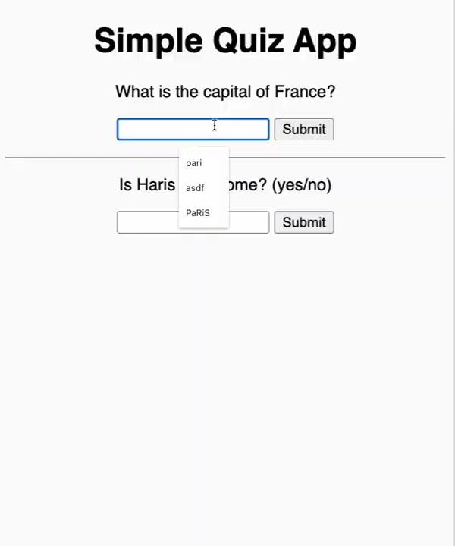
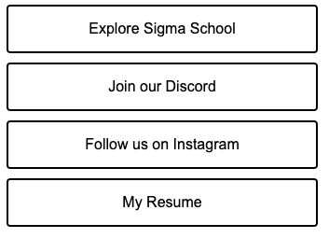
Challenge (Optional):
Notes:
Image from: Unsplash

Slide 29
Challenges (Optional)
Easy: Change question and answer!
Medium: Add question and answer!

Slide 30
Medium challenge
1. Add question. Add a new question, input, button and result. Make sure your id is different from the first one.
2. Add answer. Add a new function name and make sure is different from the first one.
Developers normally have to search on their own. Answer is on the next slide!

Slide 31
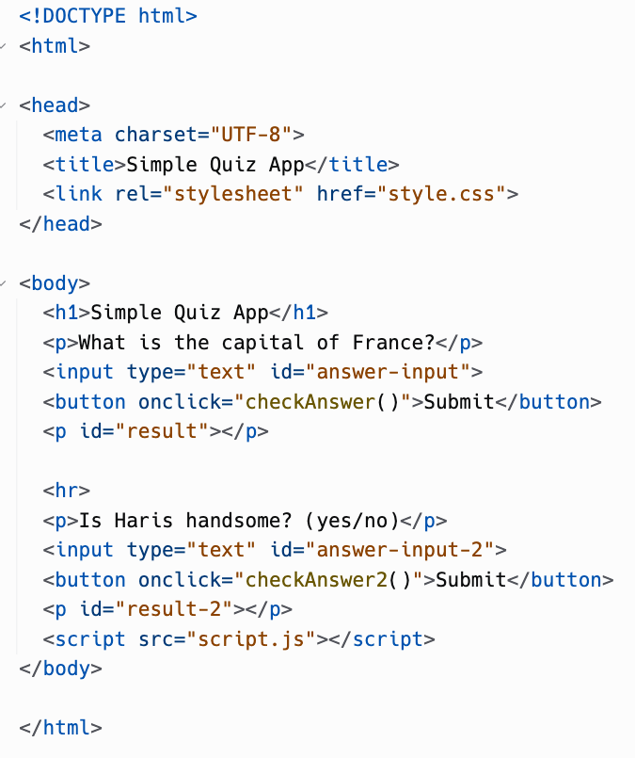
Answer for very hard challenge, index.html:

Slide 32
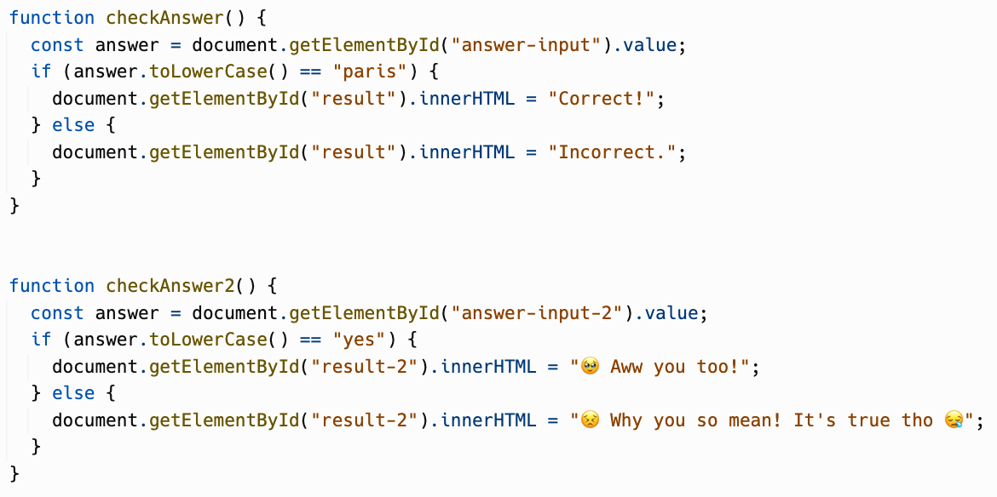
Answer for very hard challenge, script.js:

Slide 33

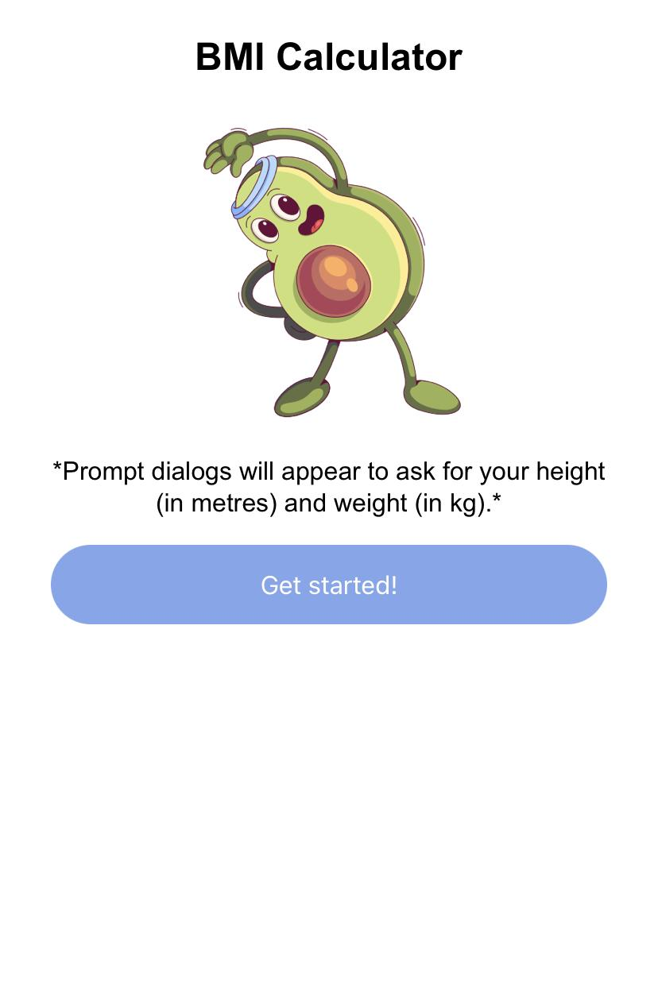
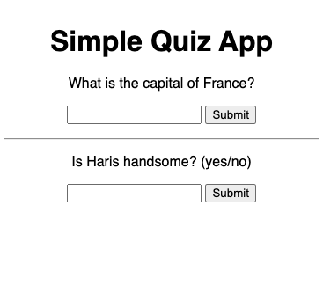
Congratulations!
You have created a quiz application!
Share it in our Discord channel here.
More specifically under the Share Your Achievements section > #i-built-this channel.
Also don’t forget to push to GitHub! Recruiters are looking at Github as well. Refer next slide on how to push to GitHub!

Slide 34
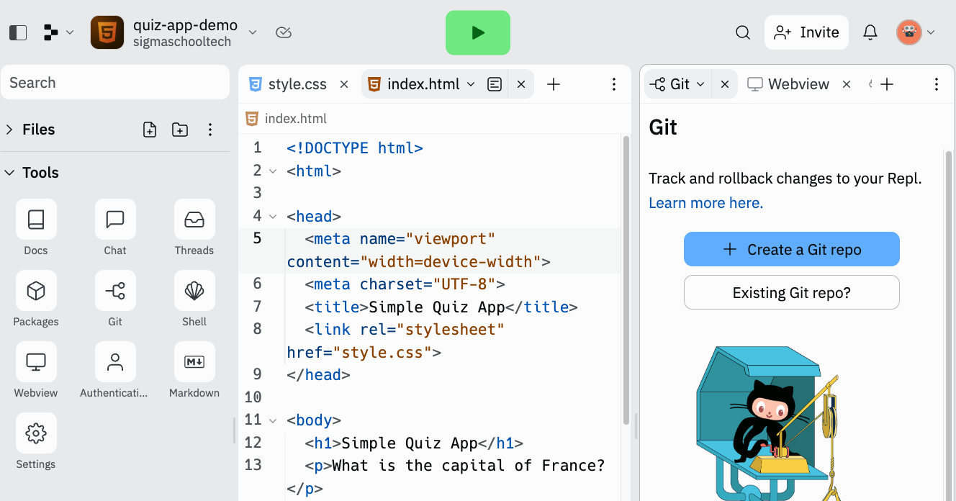
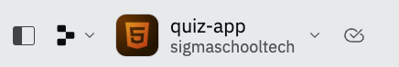
Go back to replit project Sidebar > Tools > Git.
2
1

Slide 35
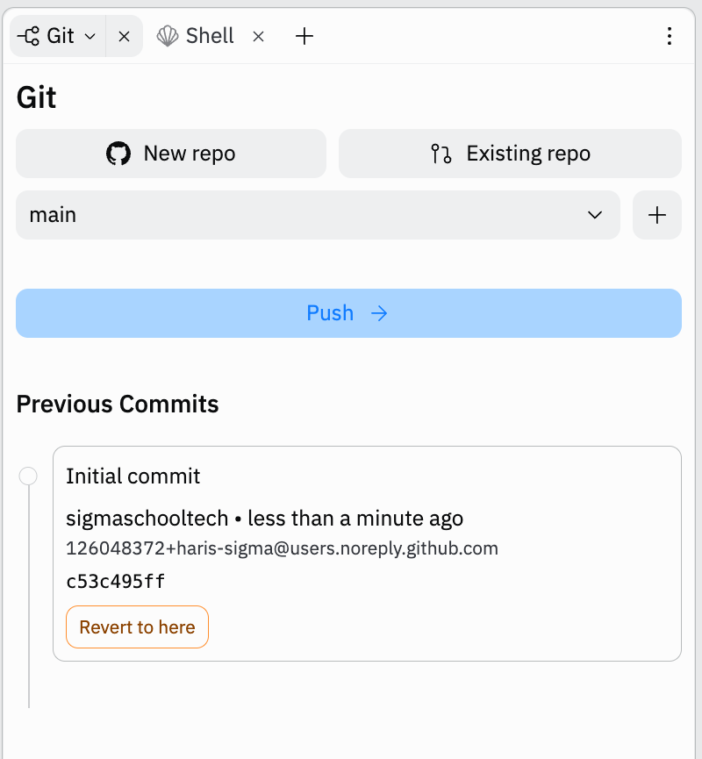
Click on New repo.

Slide 36
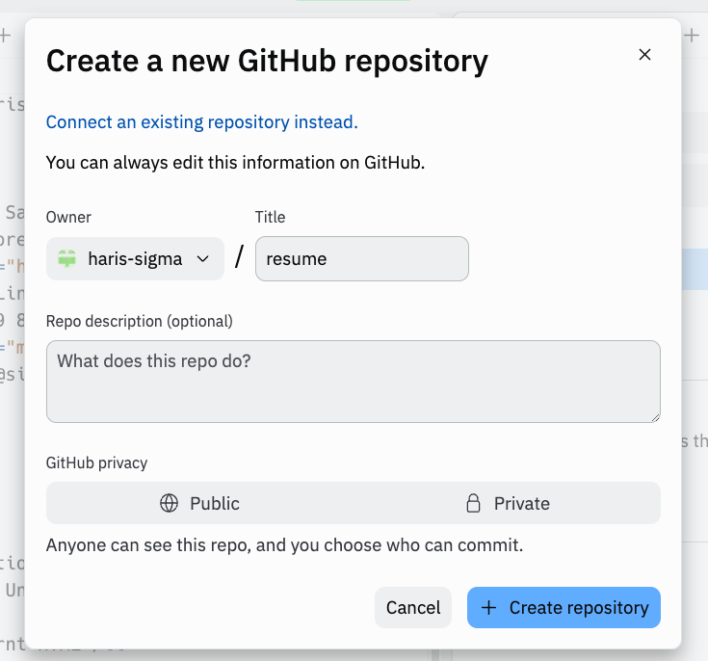
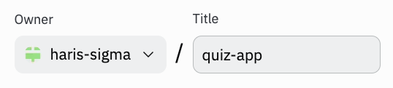
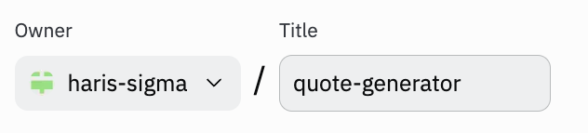
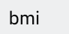
Click on Create repository button.

Slide 37
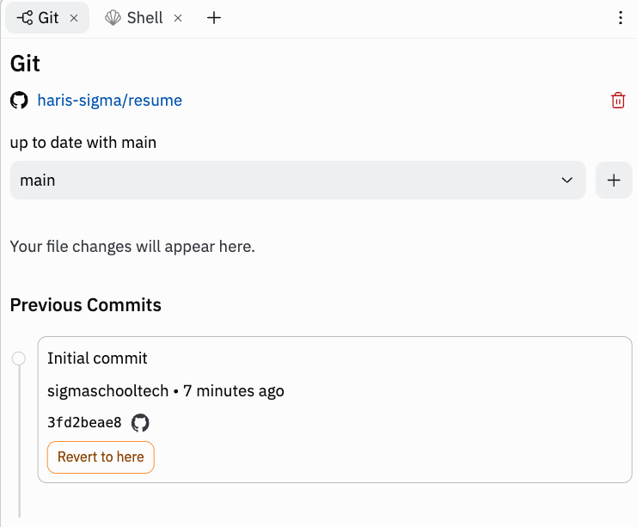
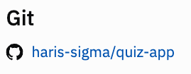
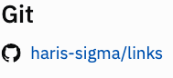
It will take a while to load. This is what it should look like. Click on your project link.

Slide 38
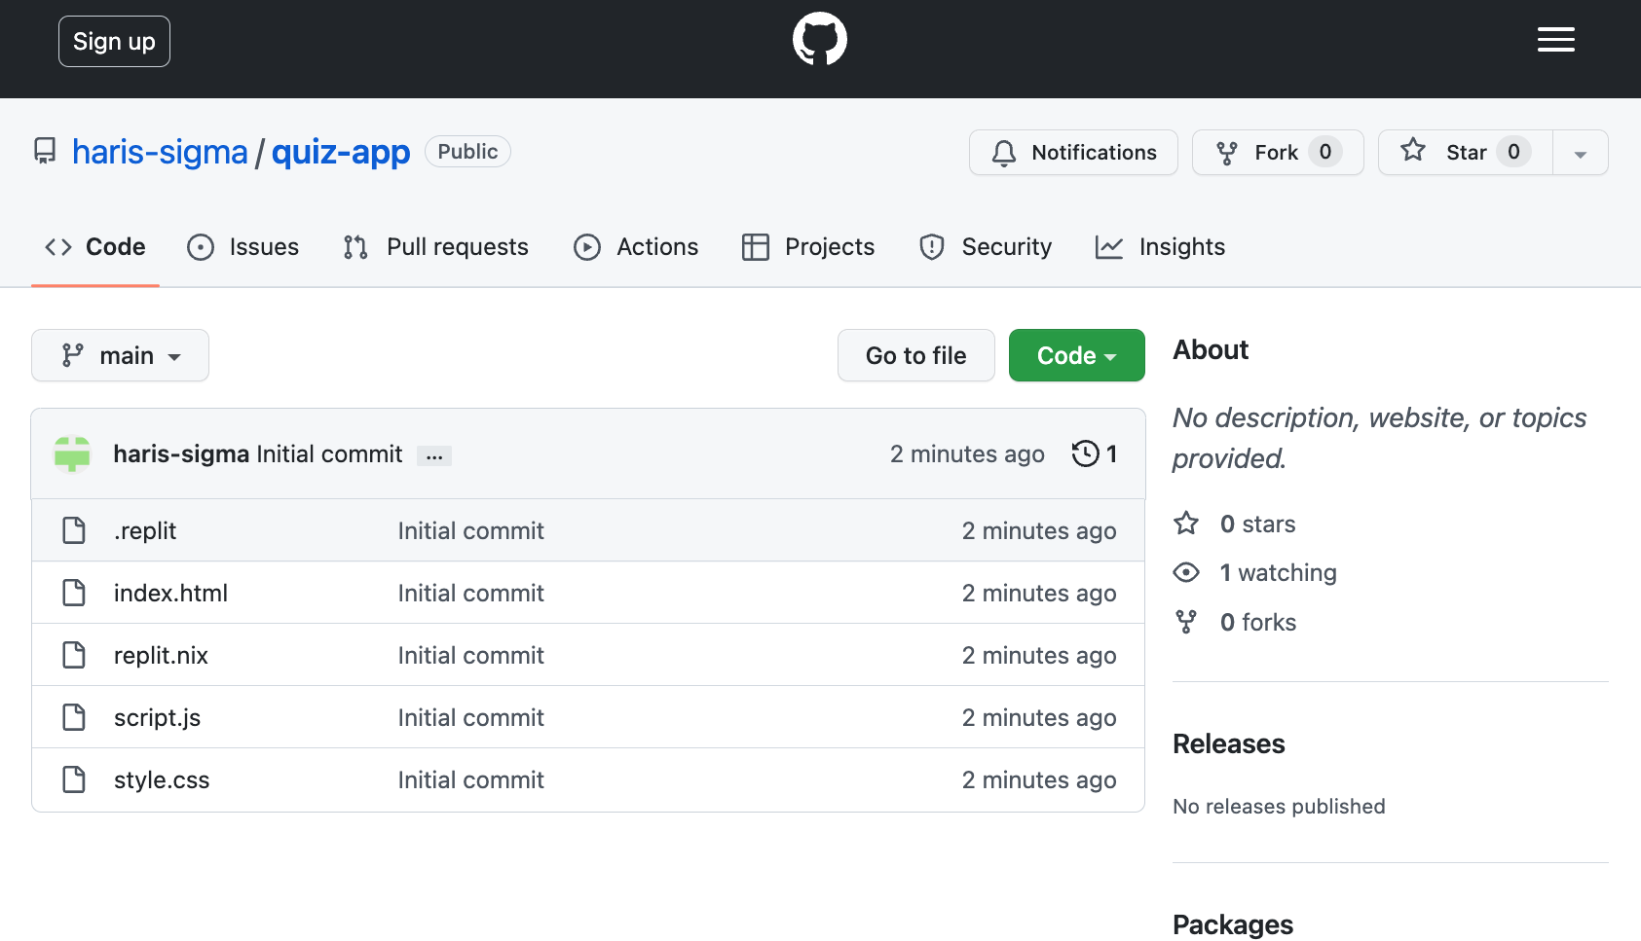
Your project have been pushed to GitHub!

Slide 39

Good work. Now, gain points!
Now that you have completed this module, you can gain points by doing this survey:
https://forms.gle/FJzRxgVw7fS2DMPY9
You can gain up to 16 points!
Currently, you can get a free Sigma T-shirt for 150 points.
There will be more freebies in the future ~
Not real. Picture is for illustration purposes.

Slide 40
Full code here:
https://replit.com/@sigmaschooltech/quiz-app-demo

Slide 41
Day 6 completed!

Slide 42
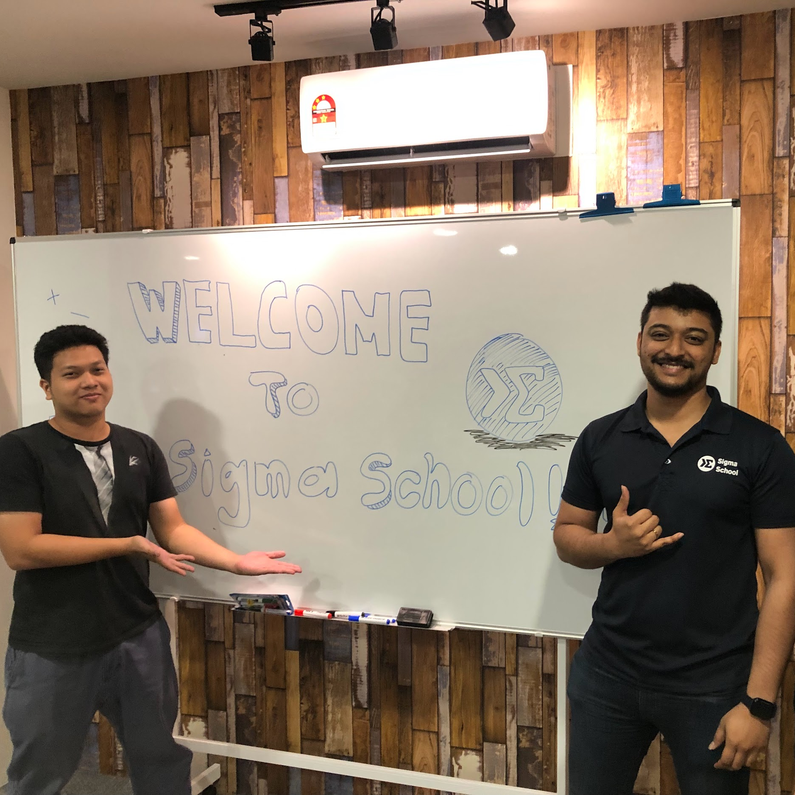
Congratulations & Thank you!
You have reached to the end but it is only the beginning.
Congrats on putting in the time and giving us an opportunity to be an early part of your learning journey in tech.
We put in a lot of our effort and time and all we want is to overdeliver help you achieve the goals that you have.

Slide 43
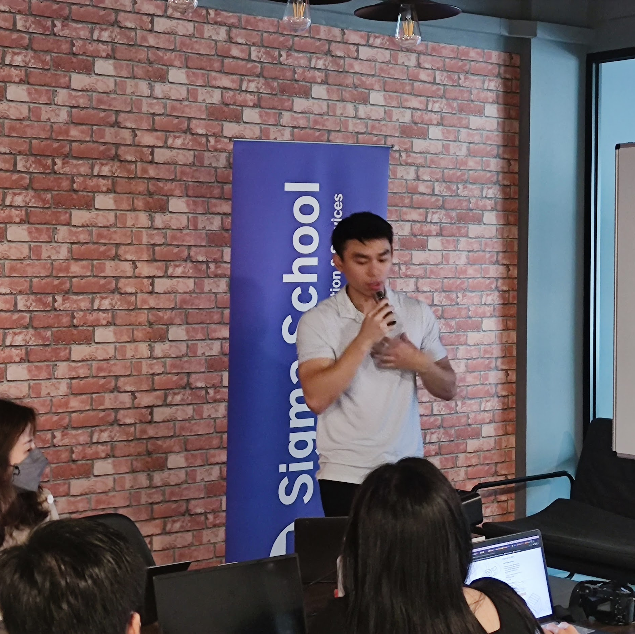
We need your support!
At Sigma School, we have only one goal: overdeliver to reach your goals!
We have big dreams to make education affordable and amazing.
However, we're still very new and cash-strapped, and going against the big players (universities/bootcamps) with deep funding will be a longshot.
We would appreciate all the support we can get!

Slide 44
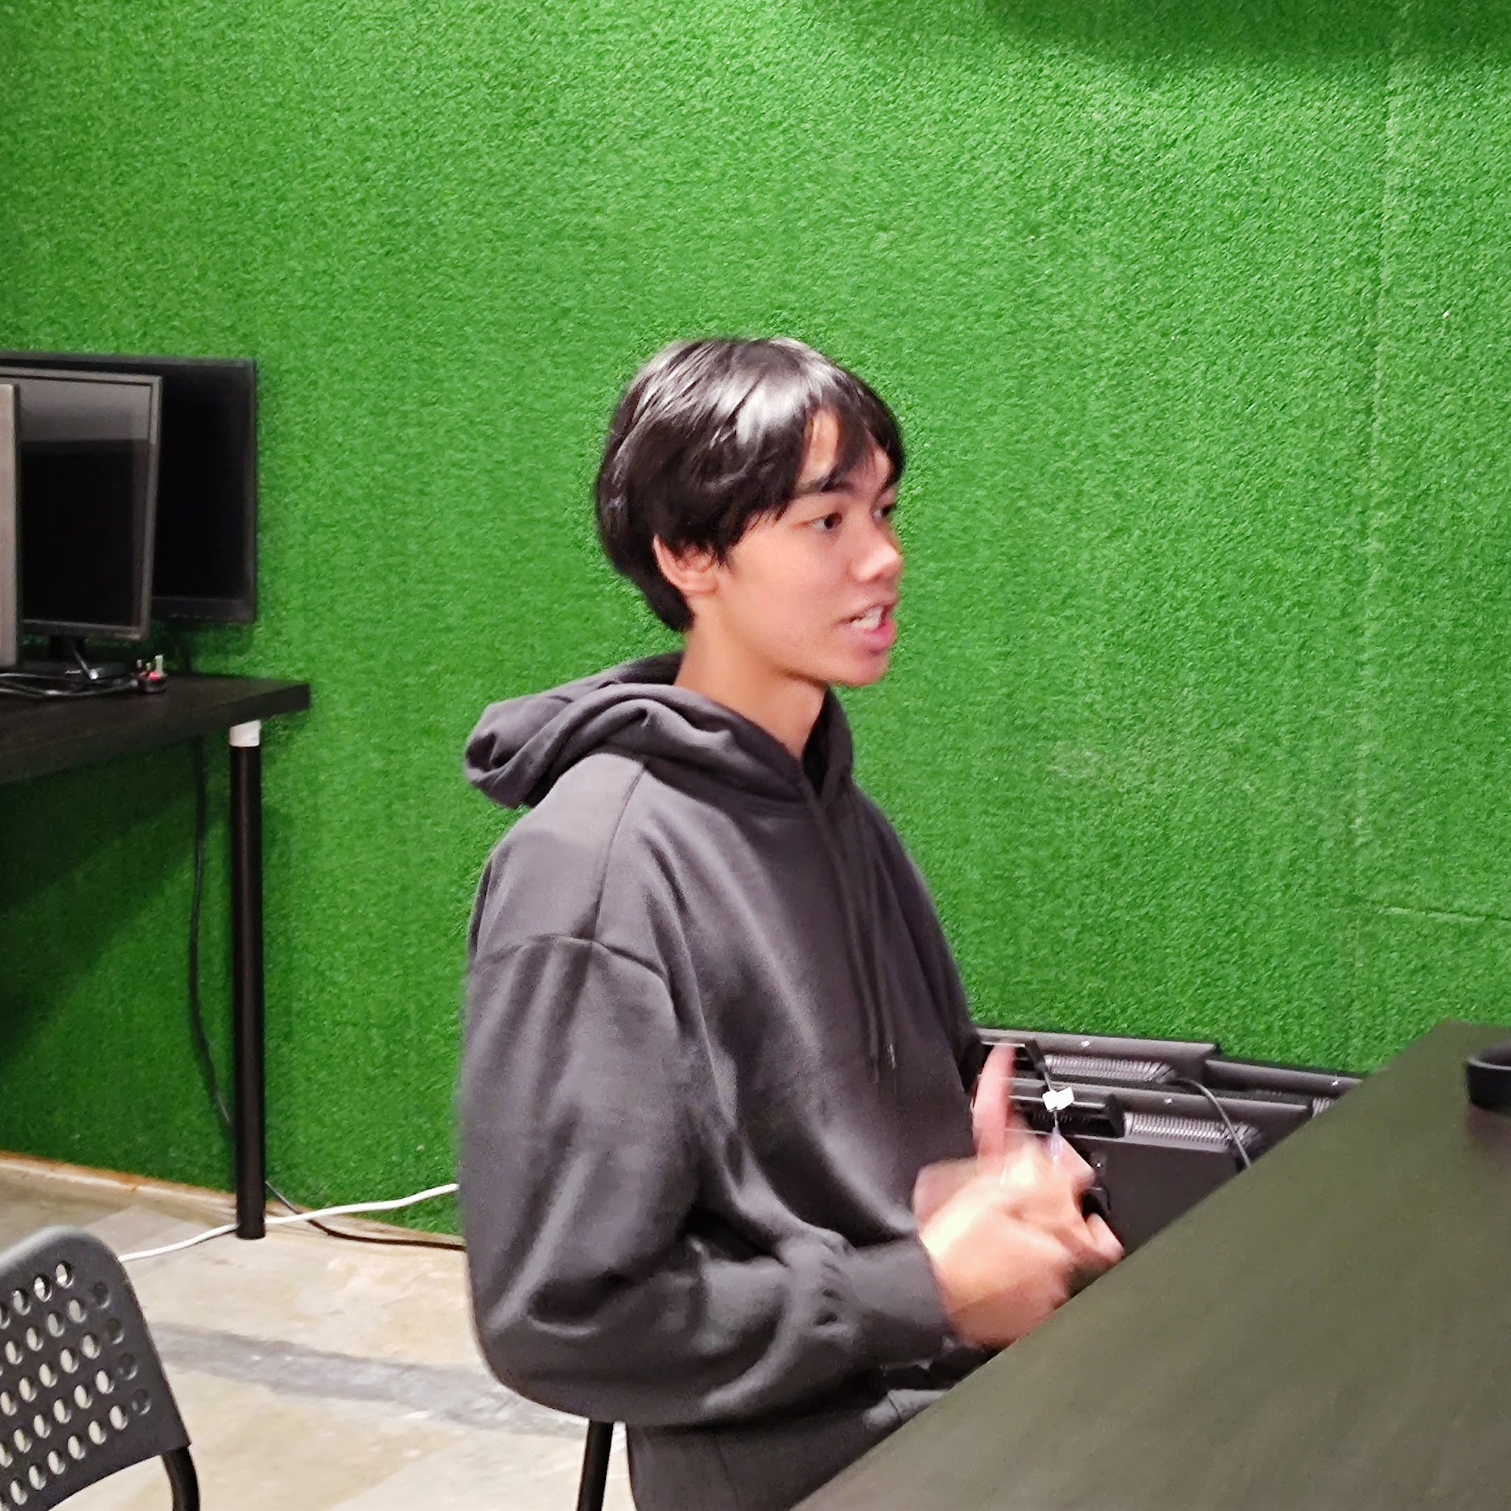
If you enjoyed the course
Follow us on our socials - Facebook, Instagram & Linkedin.
Give us a good review on Facebook here.
This would mean the world to us. This will help us continue adding value and supporting more people like you - for free.

Slide 45

How you can support us!
Refer your friends to join us!
Take a look at our referral scheme here: sigmaschool.co/referrals
Give us a shout-out on social media!
Post a write-up about about your coding journey with us in your socials and tag us, and email us at finance@sigmaschool.co
We will deliver a Sigma School merchandise (t-shirt/hoodie) to you as soon as possible

Slide 46
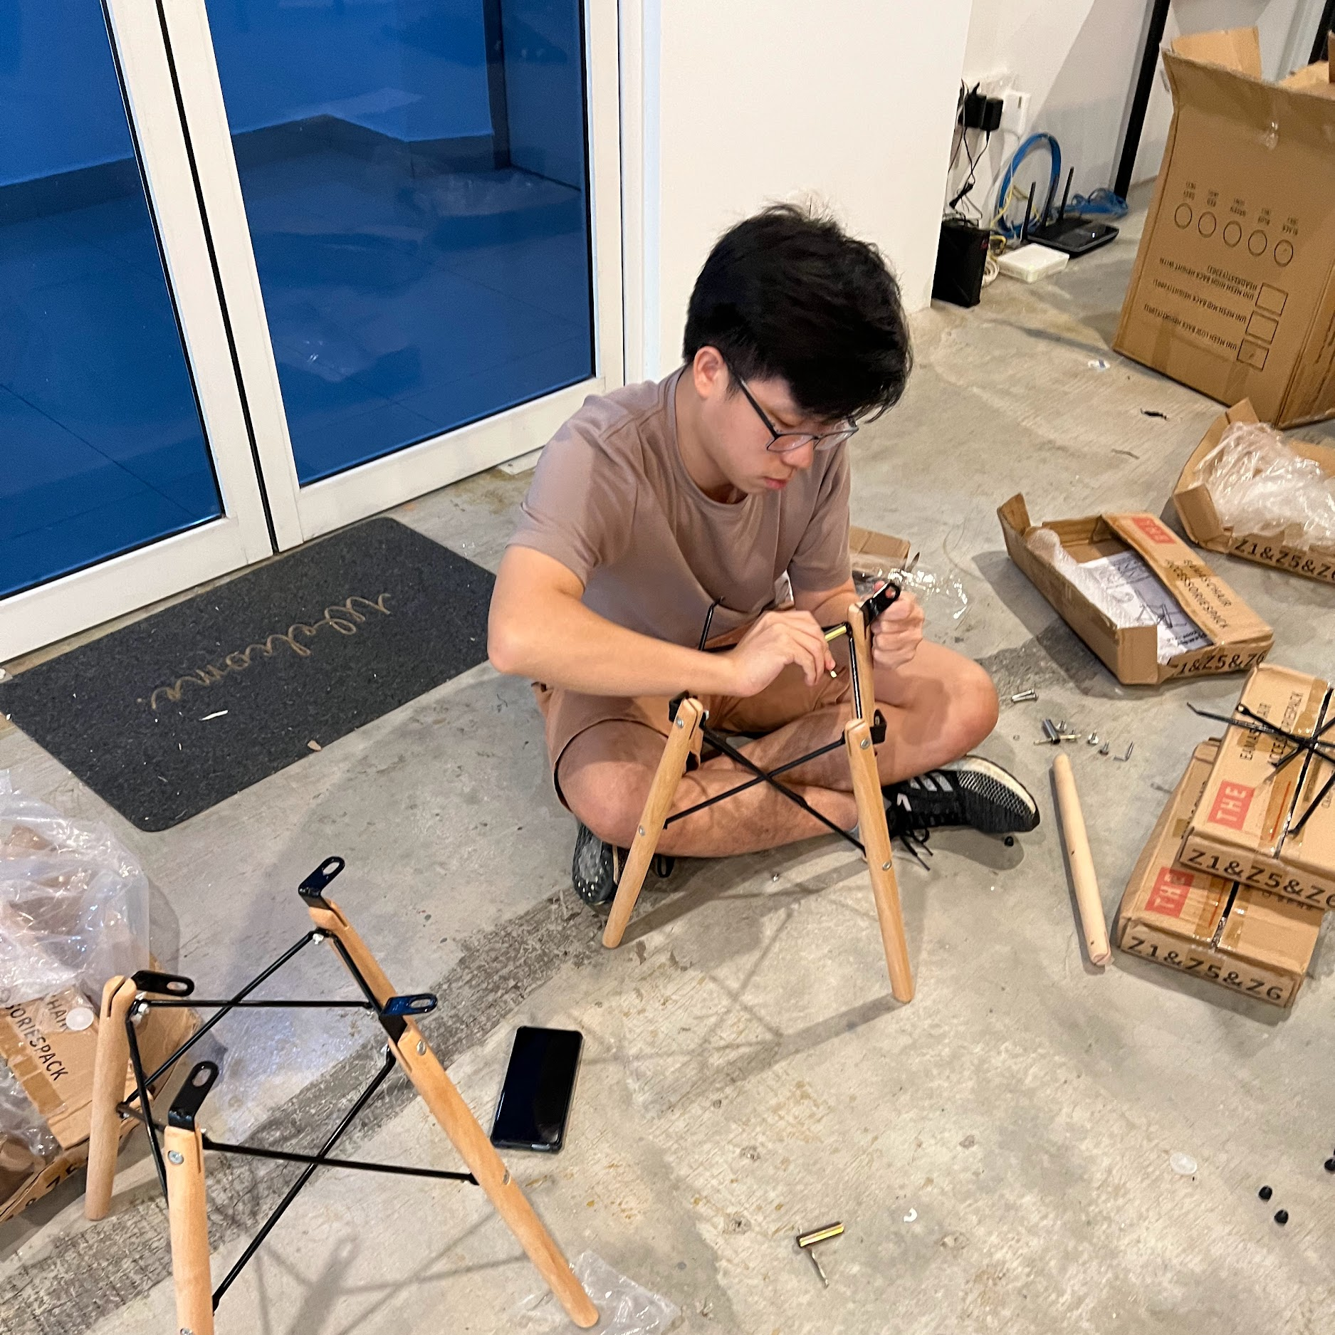
The real journey begins!
Technology evolves too fast. How fast?
Every 3 months, new tech tools are released.
How do people keep up and not get competed away or replaced by new technologies?
It's simple: build a strong tech foundation.
We can help you with that!

Slide 47
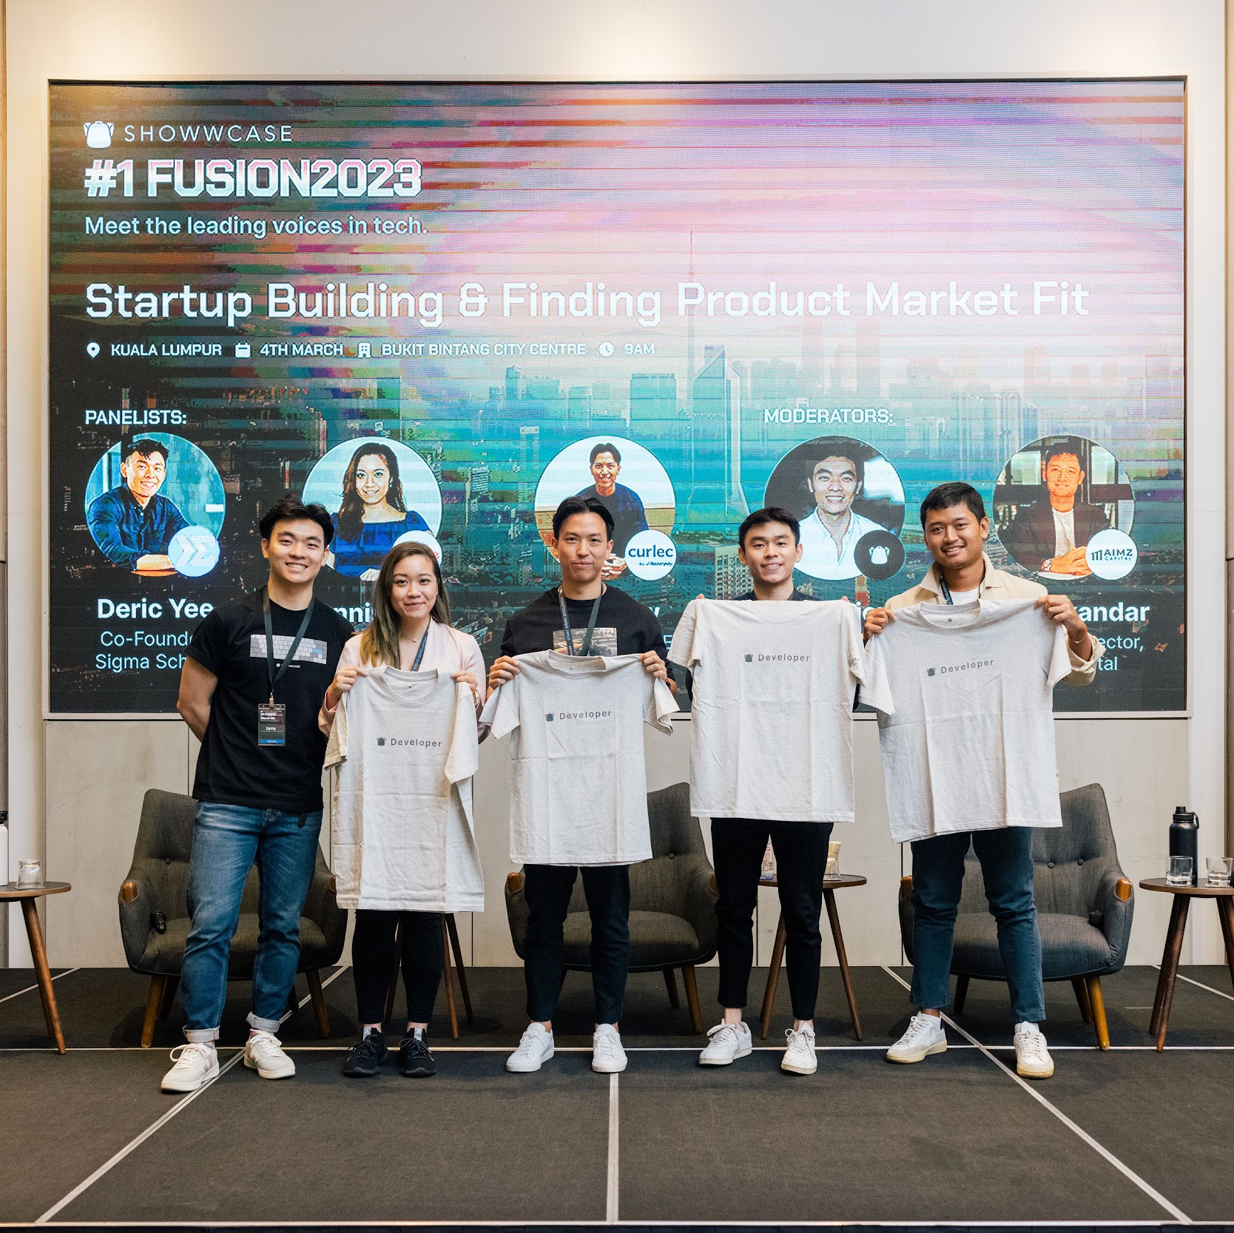
Make your journey easier!
We offer our flagship programme: Complete Software Development Programme Click on the link below to get started.
sigmaschool.co/enroll
One of our students said:
“...I have managed to 2x my salary I was getting before joining them!” - Michael Munar, Back End Developer at rethinkable.xyz

